Slide 1
Thursday, December 8, 2016
Write In Your Agenda:
Write In Your Monitoring Log:
CW:
Finish Seasons Flip Book
Seasons Crossword Puzzle and Word Search
HW:
Finish Seasons Crossword Puzzle and Word Search
Study for Seasons Quiz on Thursday 12/15/16.
Response to Warm-Up:
Describe the differences between solstices and equinoxes
You will need:
Pencil
Seasons Flip Book

Slide 2
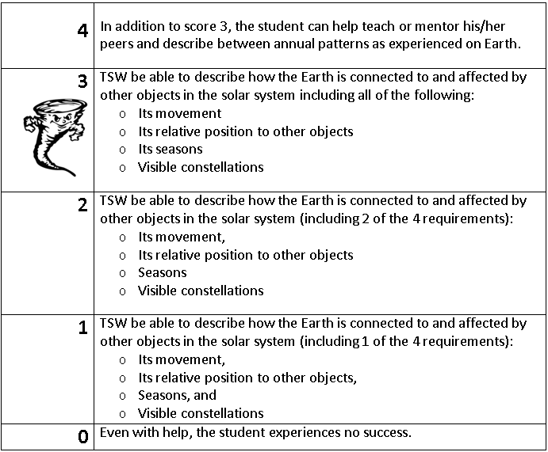
Learning Goal and Scale
TSW be able to describe how the Earth is connected to and affected by other objects in the solar system (including its movement, its relative position to other objects, its seasons, and visible constellations).

